Slide 1



All inform ation
about aPPle PhOneS
Right now

Slide 2
Right now
Represented to :
Aya Ashraf
Represented by:
Adham Albanna
Basma Mohamed
Merna Walid
Ali El-Azouny
Mohamed Ahmed Abdelkader

Slide 3
What is our site?
Right now
Our site view collection of information about Apple phones, Which includes
capabilities
Prices
Weaknesses and Strengths points
.

Slide 4
Right now
What distinguishes our site from
other websites?
ram : 4
camera : 12 + 12
front camera : 12
proccecor:Apple A13 Bionic
storage : 128
price : 1700 LE
os : IOS 13
our site make it easy for us to see the deference between the phones clearly so you can compare between their
Capabilities , prices , advantages and defects and also you do not have to search for each piece of information separately.

Slide 5
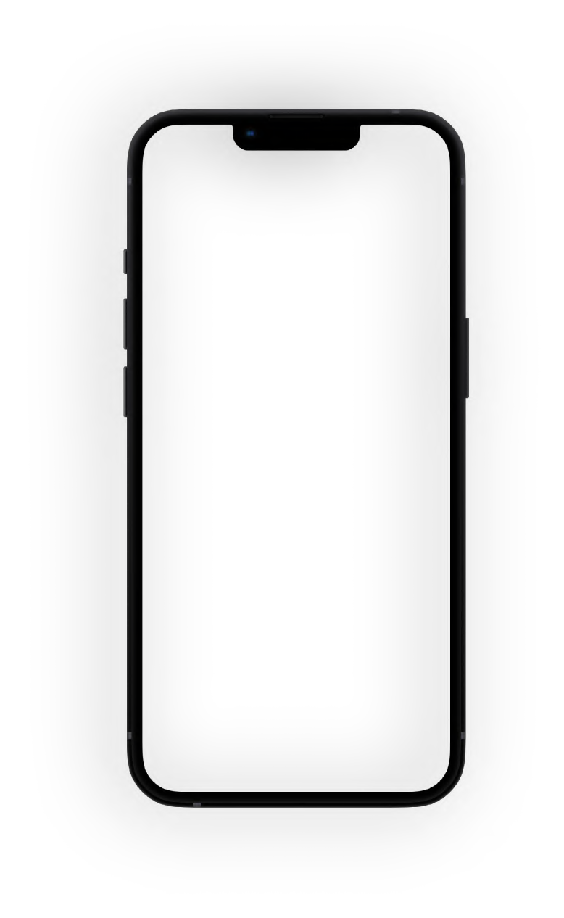






Right now
camera :
camera :
12 + 12 +
12
iphone 11 pro max
camera :
12 + 12
12 + 12 +
12
iphone 11 pro
iphone 11
it's much better than seeing them separately right ?

Slide 6
when you find all the information and prices in front of your eyes, it makes it easier in
Right now
•
making your choice according to your budget .
saving you time and effort in order not to search for each piece of
information separately .

Slide 7
Right now
it also reduces the greed of merchants because you will be aware of the price of the phone before you buy it .
.

Slide 8

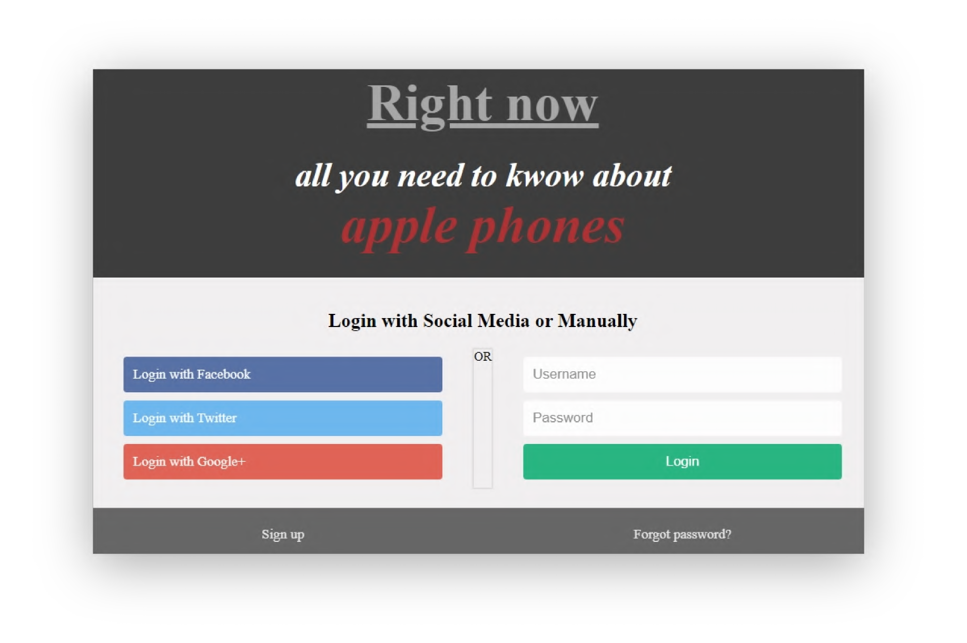
Right now
our site is very easy to use
first you have to login with your account or with
Facebook
Twitter
Google+
and if you have no accounts you
Can go to the sign up page to make one and same if you forget your password.

Slide 9
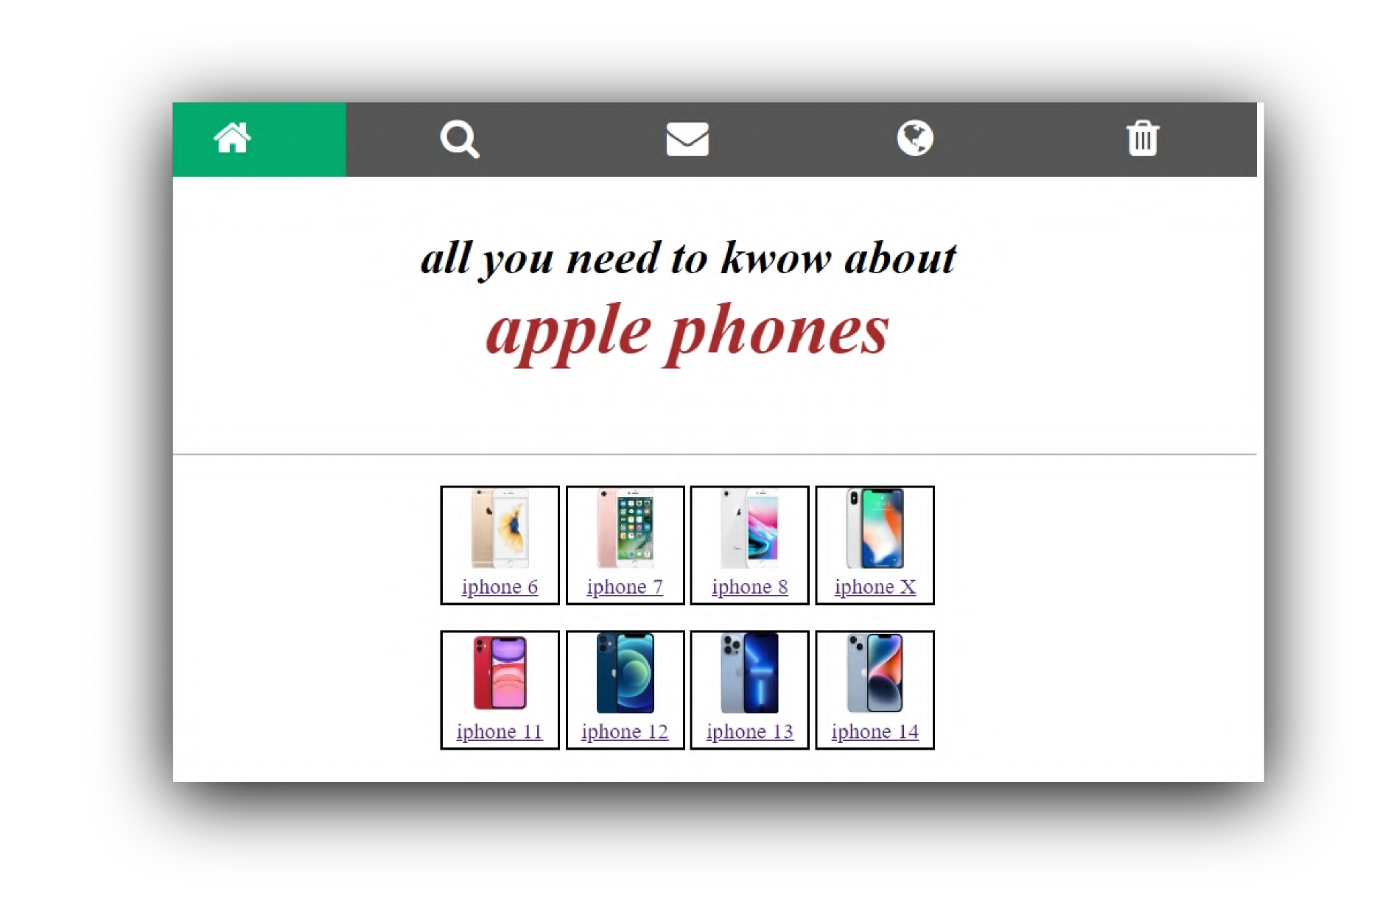
Right now
Now you are in the home page
you can choose any mobile you want and all the collection will appear in front of you

Slide 10
Thank You

